Slide 1
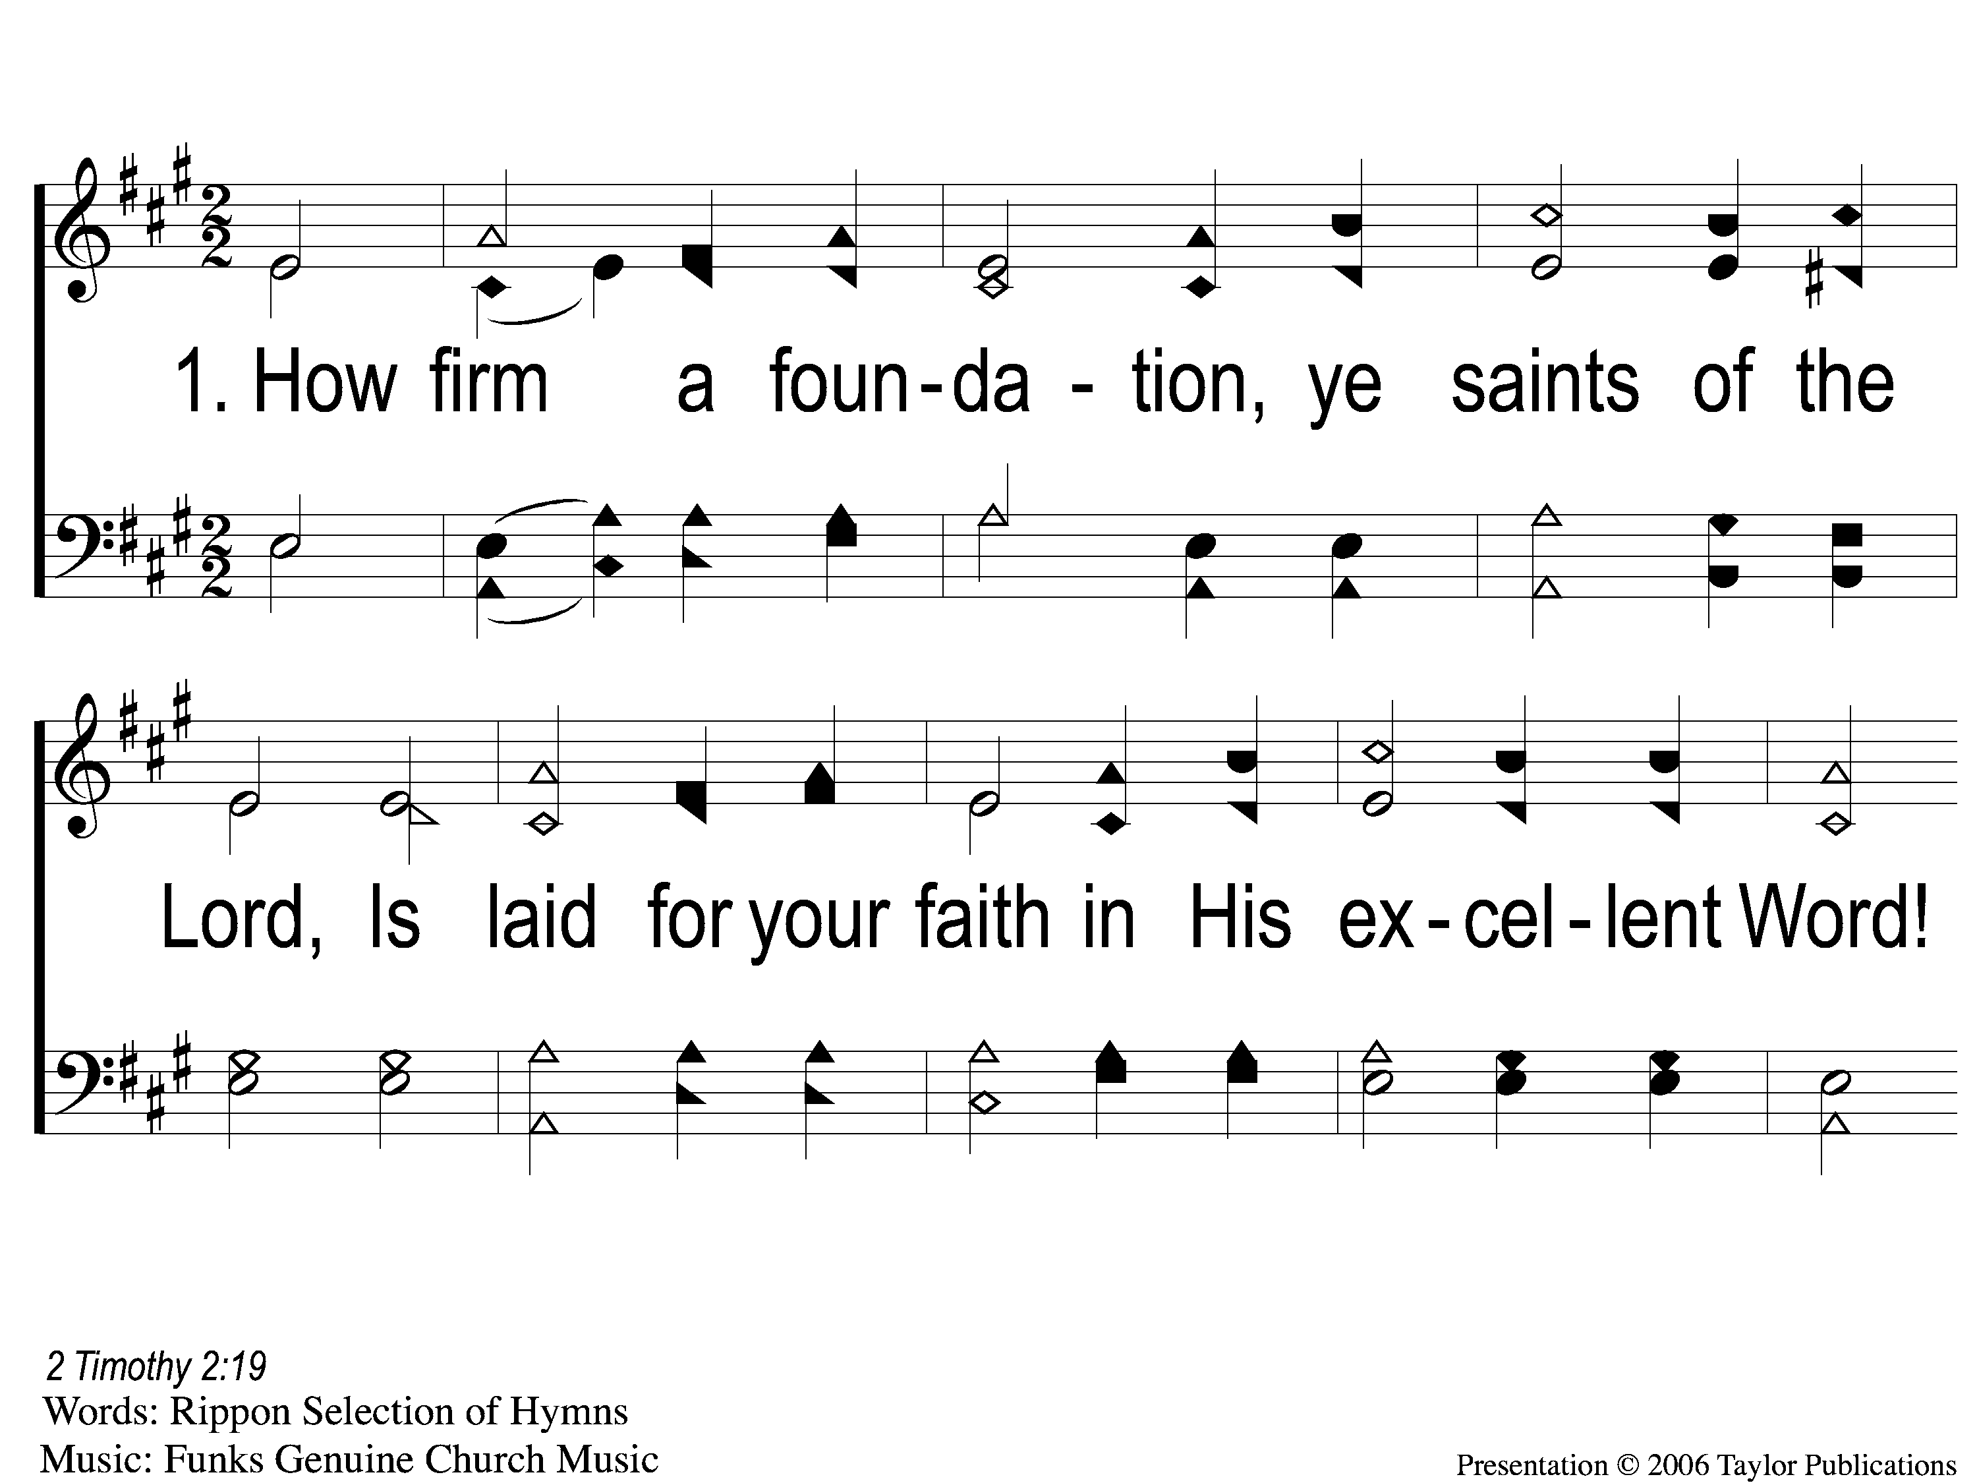
1-1 How Firm a Foundation
How Firm A Foundation
178

Slide 2
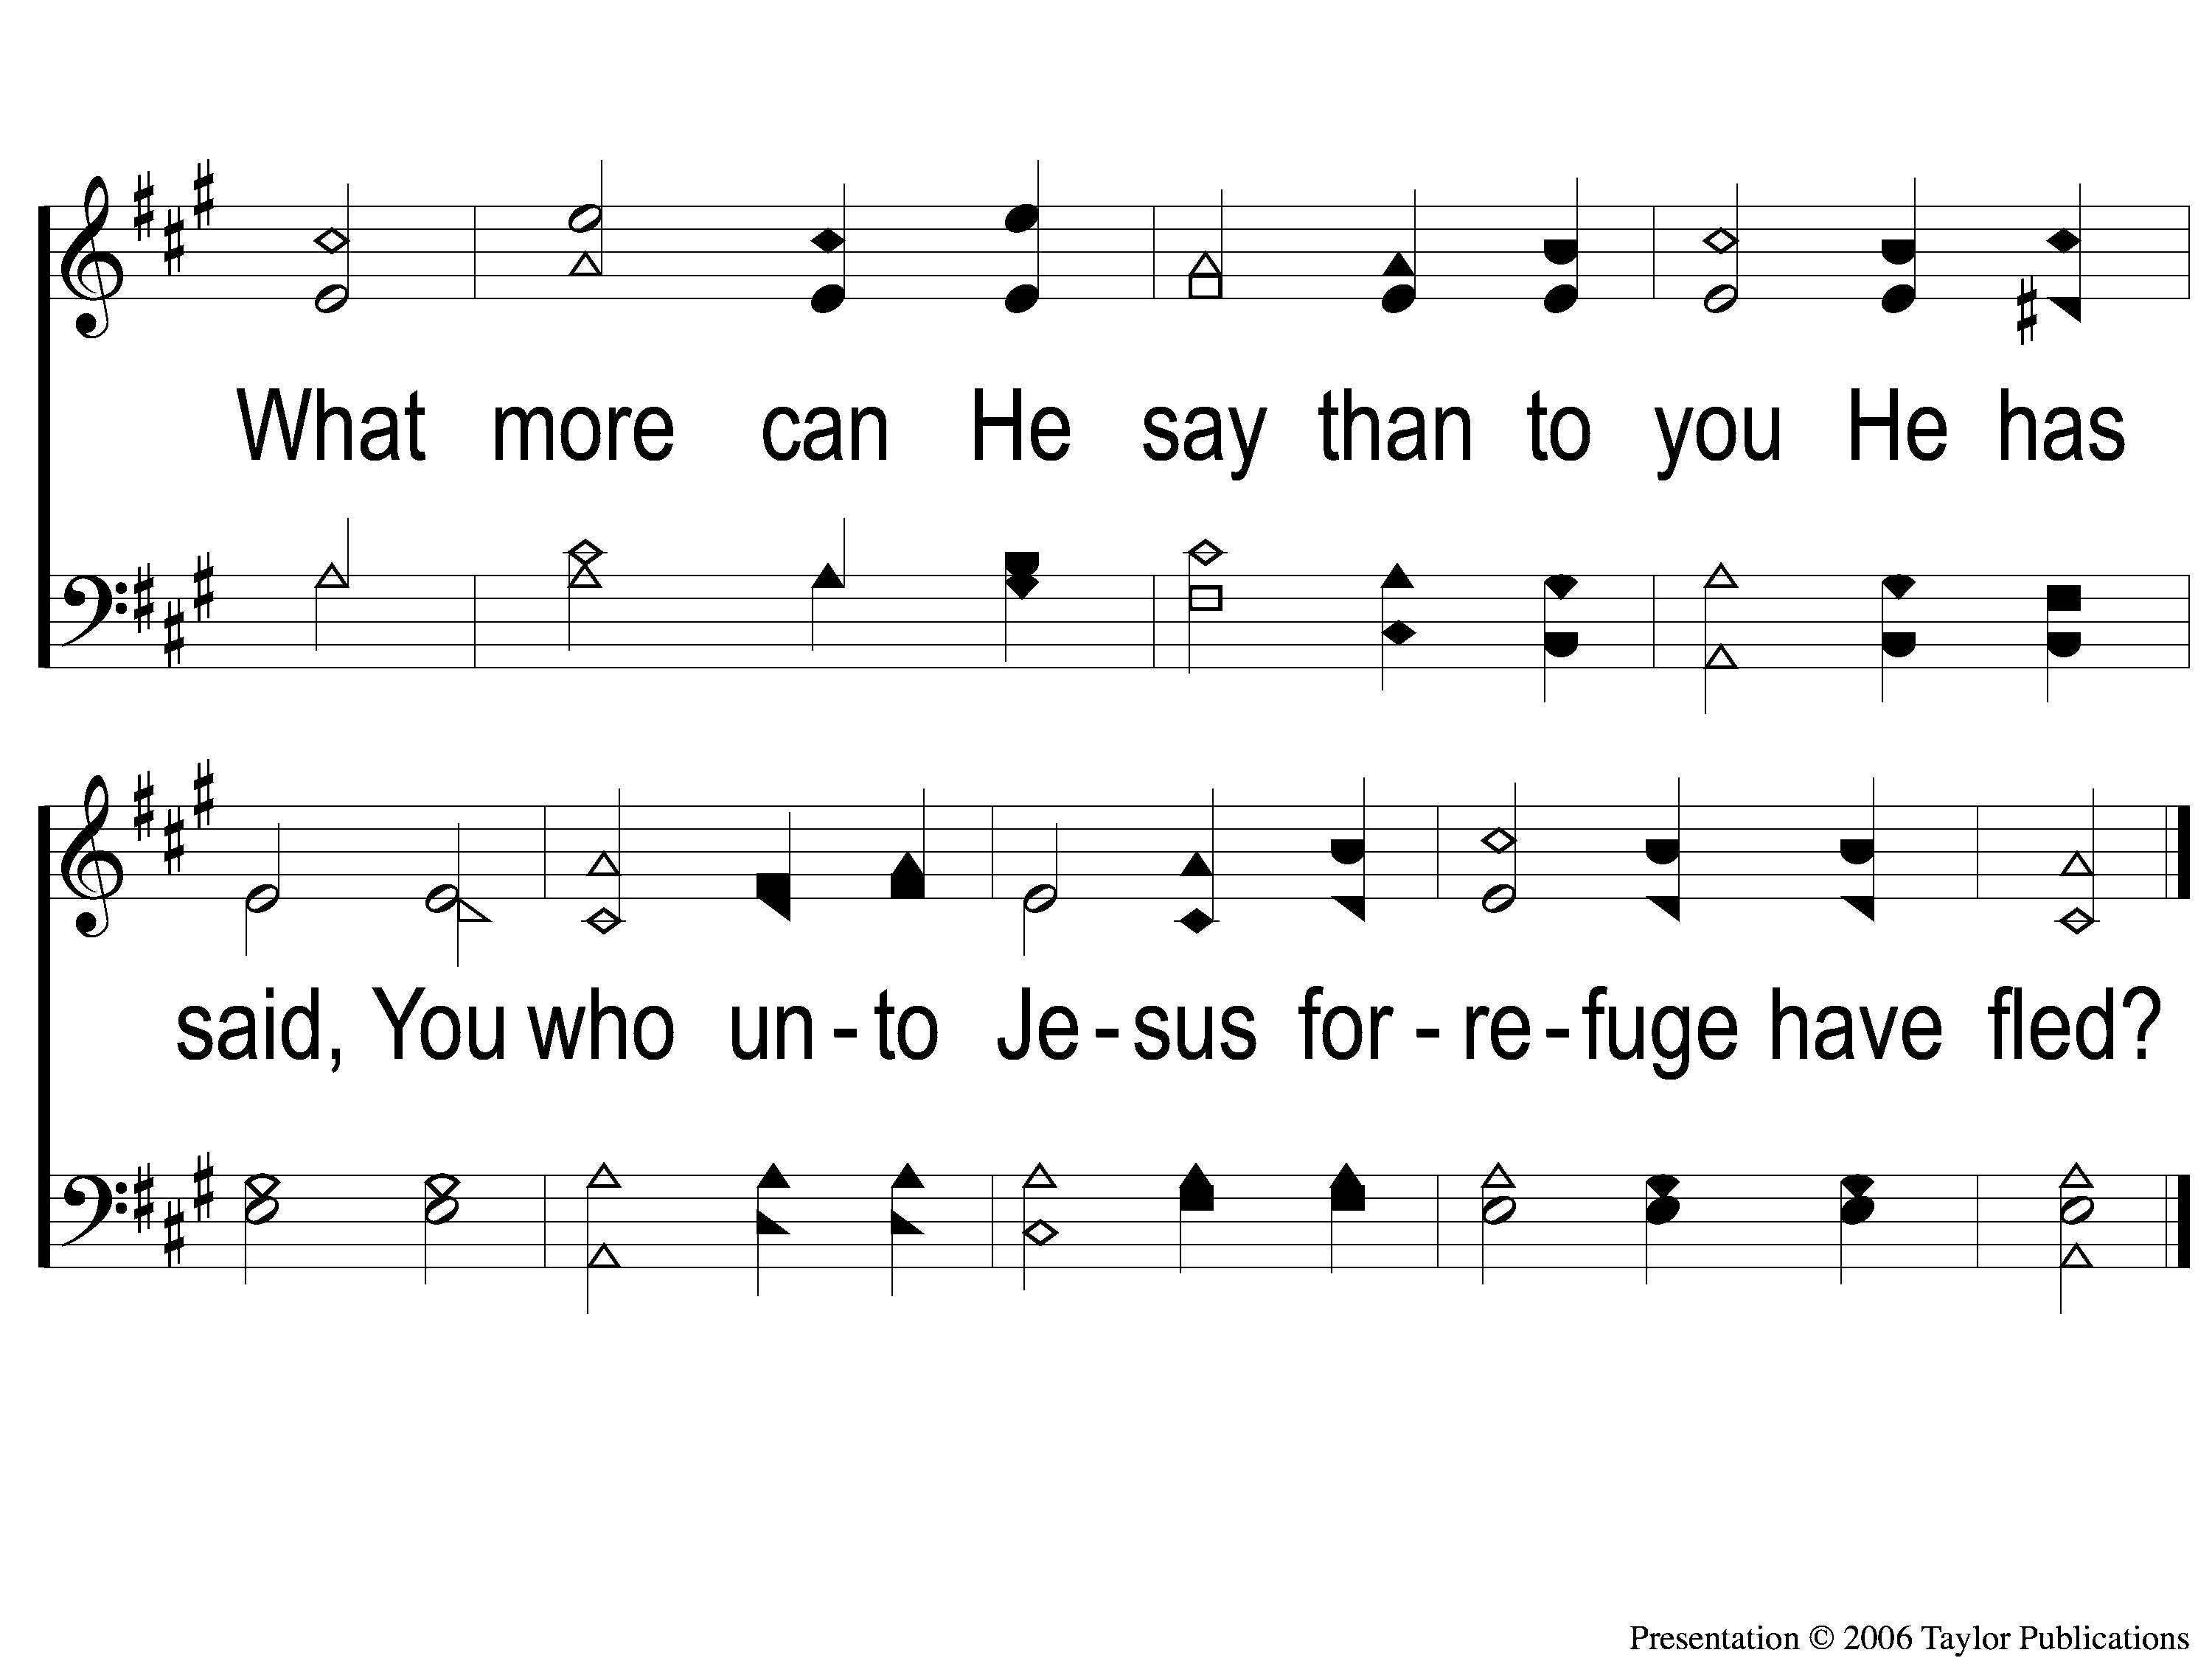
1-2 How Firm a Foundation
How Firm A Foundation
178

Slide 3
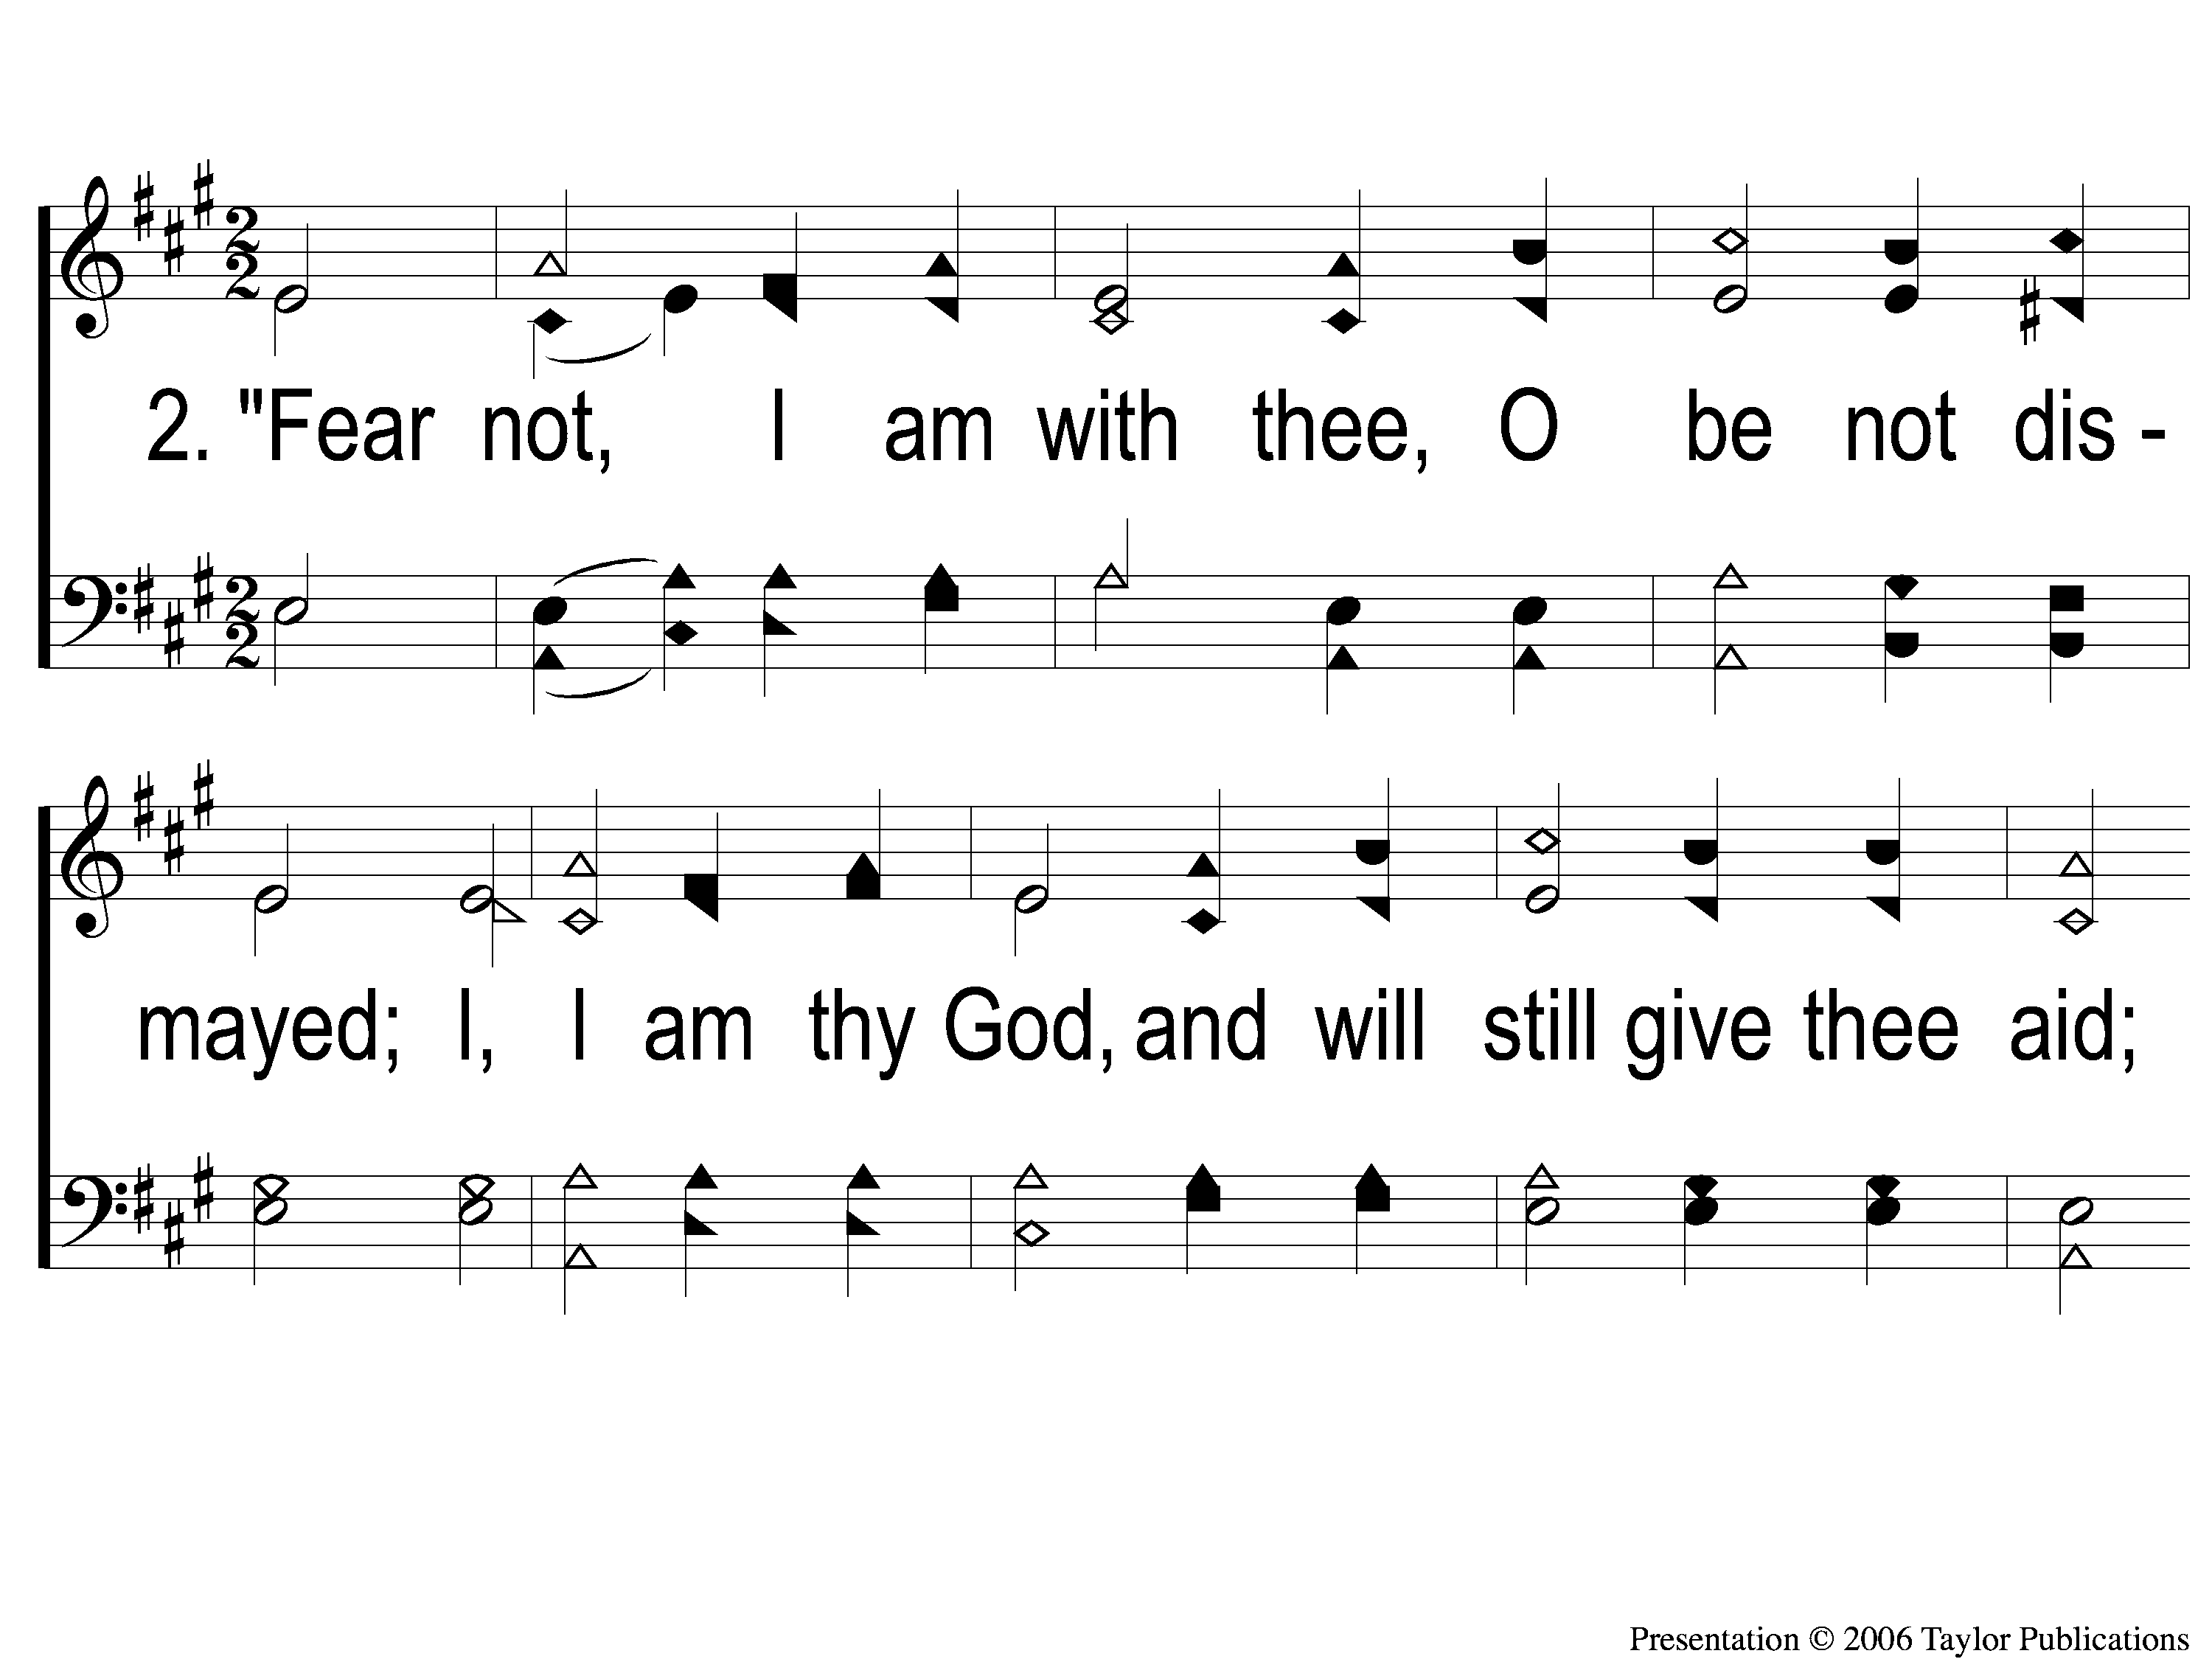
2-1 How Firm a Foundation
How Firm A Foundation
178

Slide 4
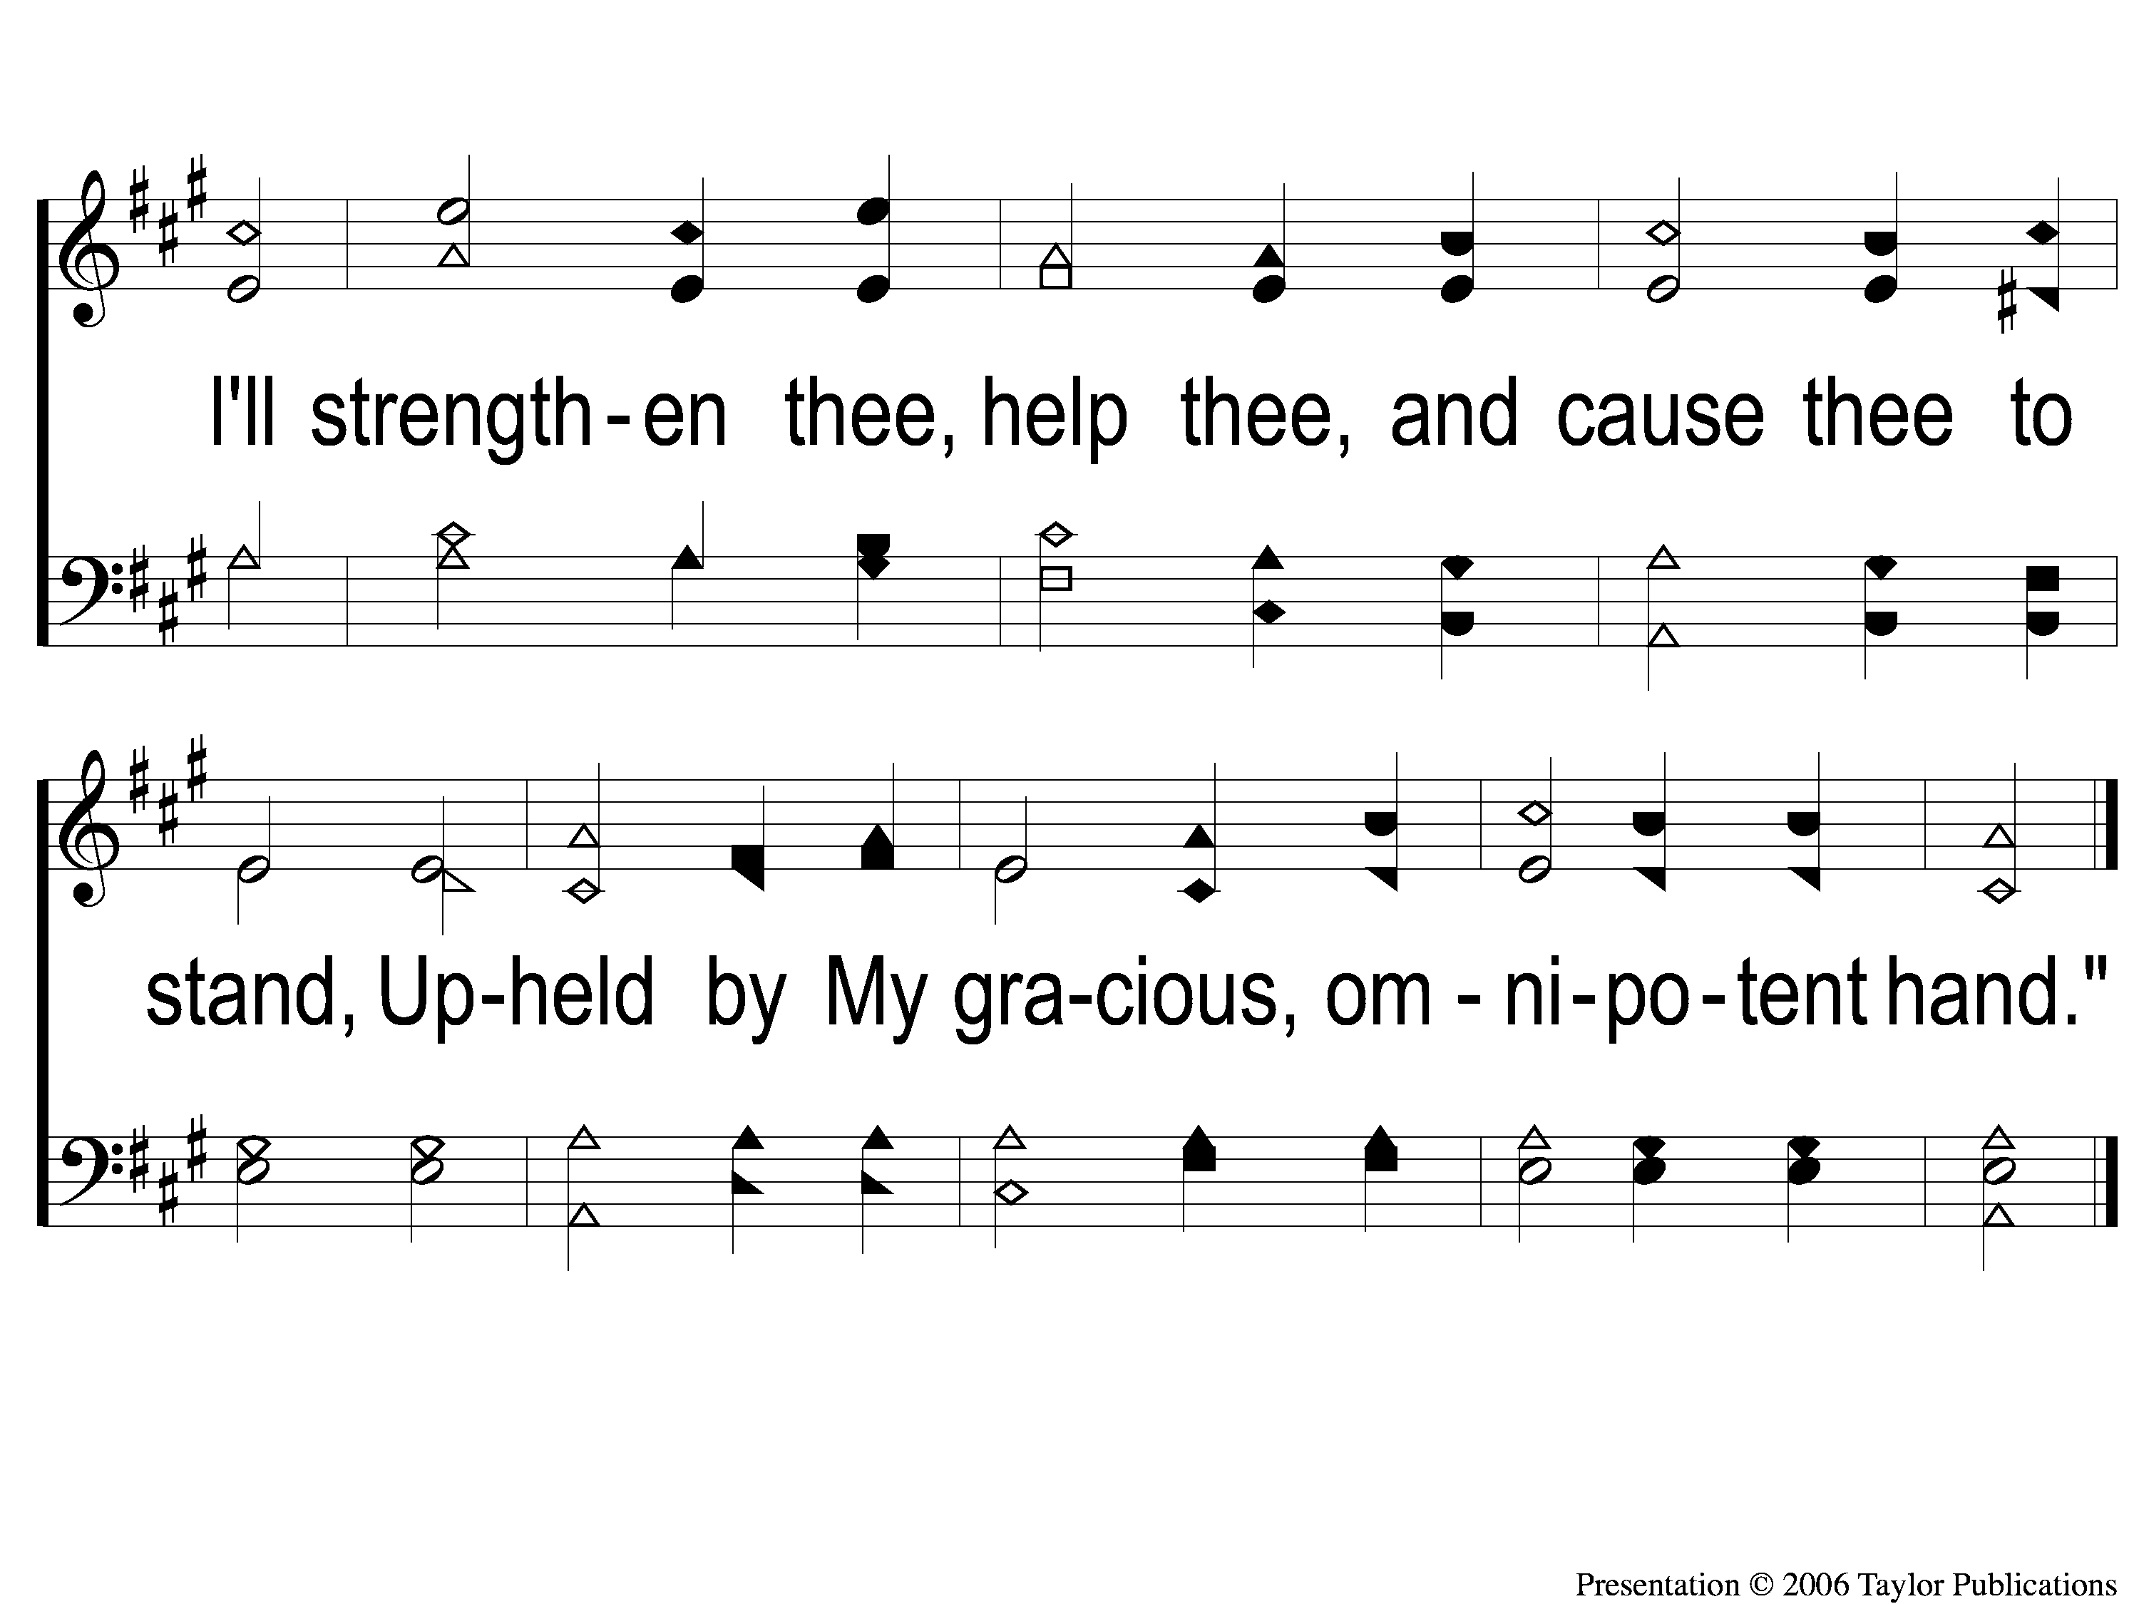
2-2 How Firm a Foundation
How Firm A Foundation
178

Slide 5
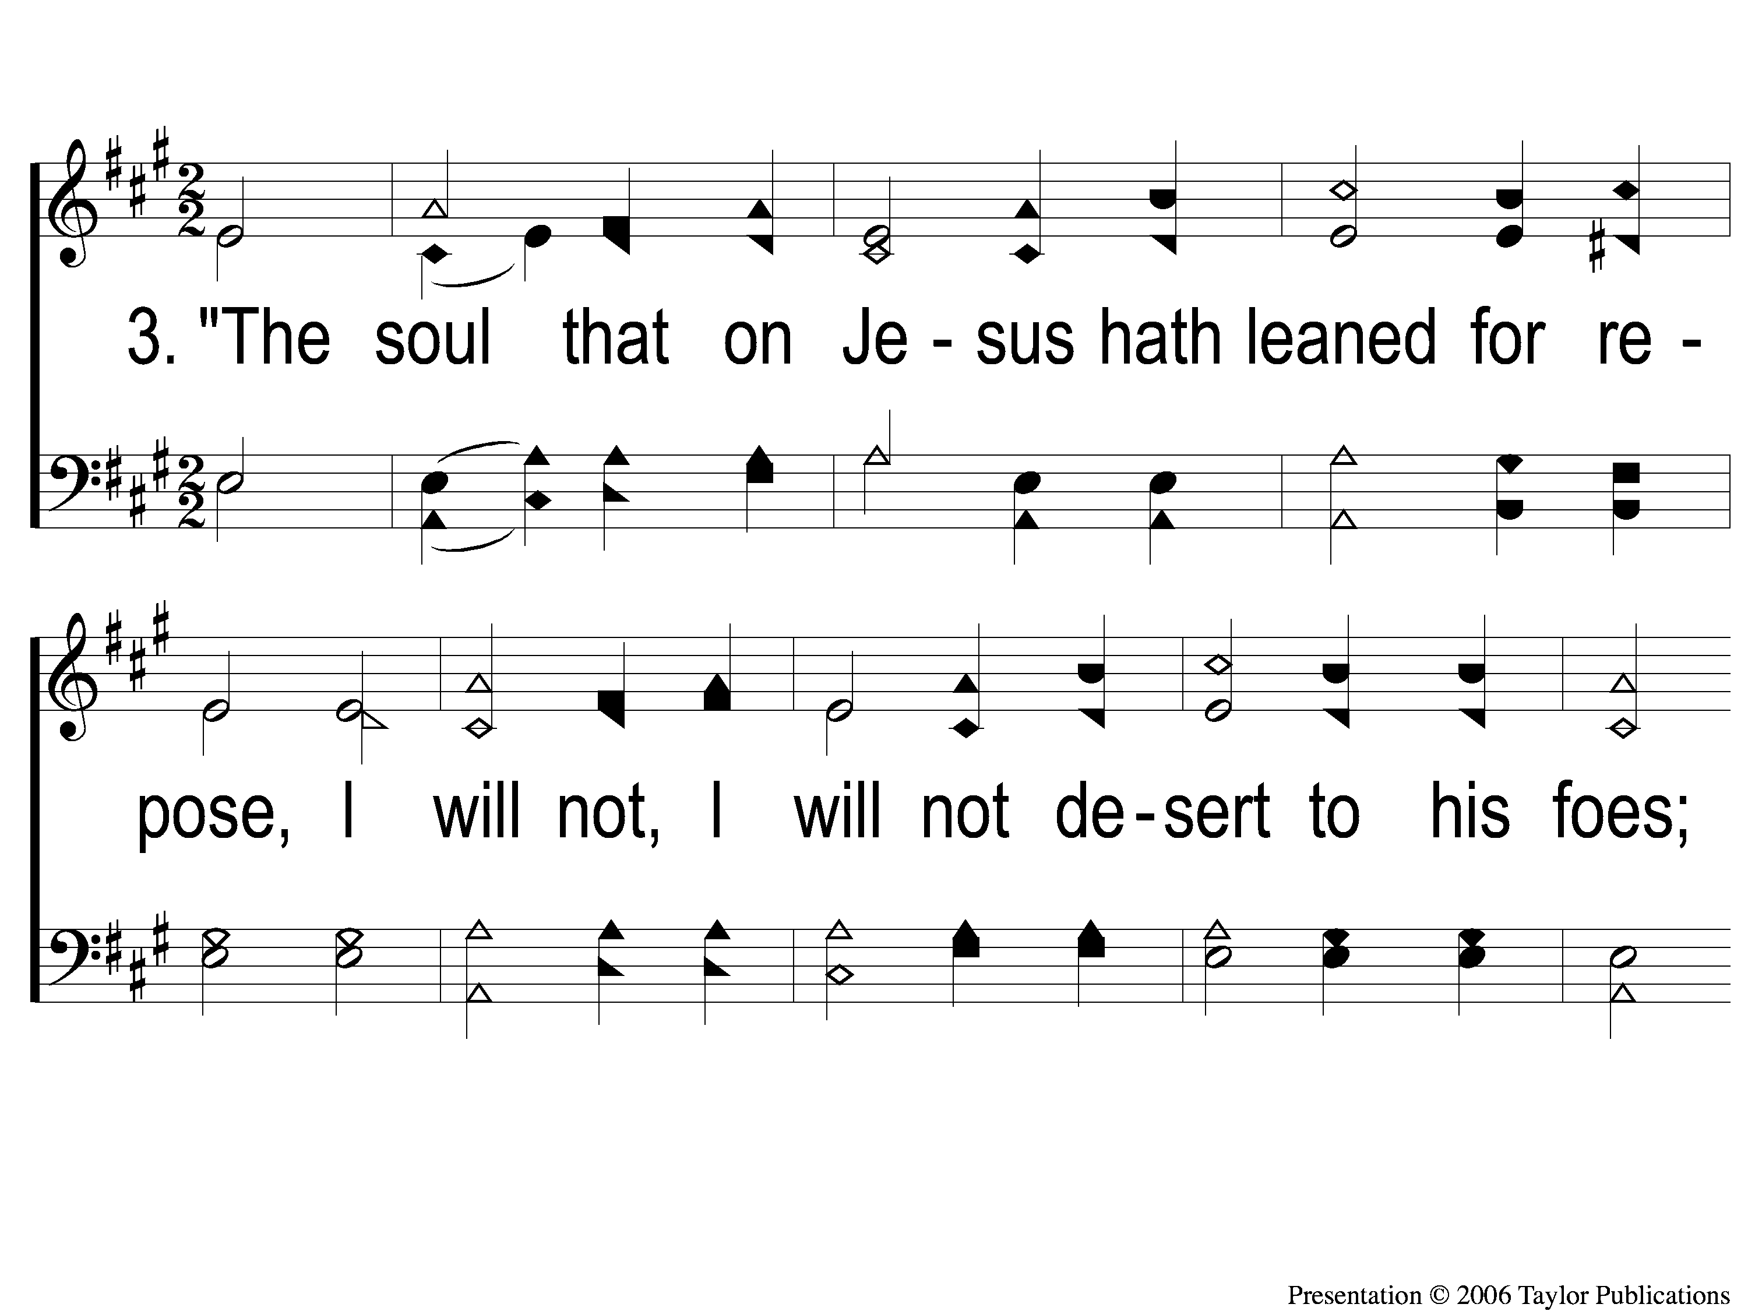
3-1 How Firm a Foundation
How Firm A Foundation
178

Slide 6
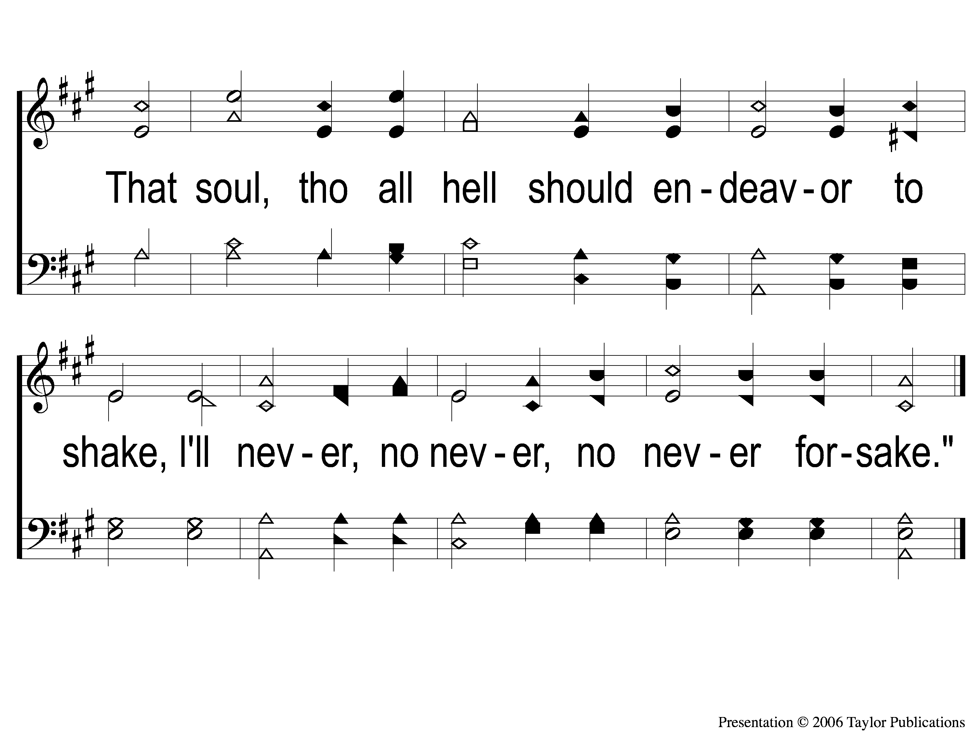
3-2 How Firm a Foundation
How Firm A Foundation
178

